Slide 1

StreamList React
Pantea Namiranian
The University of Arizona Global Campus
INT499: Capstone for Information Technology (INP2520A)
John Russell
5/13/2025
Notes:
Hello everyone! My name is Pantea Namiranian, and I’m excited to present my StreamList React application today.

Slide 2

Program Design Overview
The concept of the application
User experience
Notes:
In this video, I will showcase the functionality of the StreamList application, which allows users to create and manage their personalized streaming lists.
The StreamList application is designed to help users keep track of movies and programs they want to watch. Users can input titles into the app, similar to creating a grocery list.
User experience is crucial for this application. I focused on creating a clean and intuitive design that makes it easy for users to navigate and input their data without any hassle.

Slide 3
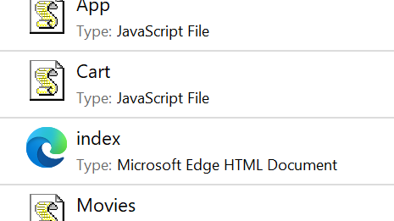
React Application Structure
Overall structure
The use of React Router
Notes:
[Describe the overall structure]
"The application is structured using React components, with a main App.js file that sets up routing for different pages."
[Explain the use of React Router]
"I utilized React Router to manage navigation between components, allowing users to switch seamlessly between the StreamList, Movies, Cart, and About pages."

Slide 4
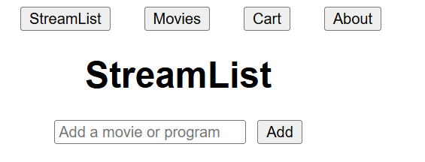
Components and Navigation
Notes:
[StreamList Page (Homepage)]
"The StreamList component serves as the homepage. It includes a form where users can enter the title of a movie. When submitted, the input is logged to the console."
[Movies Page]
"The Movies page is planned for Week 4 and currently does not contain any data. It will be developed further to display movie-related information."
[Cart Page]
"Similarly, the Cart page will also be built in Week 4 and will not contain any data yet."
[About Page]
"The About page is set for development in Week 5 and will provide information about the application."

Slide 5
Styling with CSS
CSS is used extensively to style the application, ensuring that it is visually appealing and user-friendly. For example, in the App.css file, I defined styles for the navigation bar, input fields, and overall layout.
Some key styles include centering text, adjusting margins for navigation items, and styling the input field for better usability.
Good styling enhances user experience, making navigation intuitive and interactions enjoyable.

Slide 6

Development Process
Outline the steps taken
Planning the features
Setting up the environment
Creating components
Implemented routing and styled the application using CSS.
Mention challenges faced
Managing the state effectively within the StreamList component
Notes:
[Outline the steps taken]
To develop the application, I started by planning the features,setting up the environment, and creating components. Iimplemented routing and styled the application using CSS.
Mention challenges faced
One challenge I encountered was managing the stateeffectively within the StreamList component. With practice, Ilearned to use the useState hook efficiently.

Slide 7

Video Presentation Application File
You can find the complete code for the StreamList application in my GitHub repository at [GitHub Repository Link].
Notes:
Now, I will demonstrate how the application functions, showcasing the various components and how users can navigate through the app.
You'll see how the input form works in the StreamList component, and how users can switch between the different pages using the navigation bar.
Thank you for watching my presentation on the StreamList application.
I welcome any feedback or questions regarding the application design, and I look forward to your thoughts!
Also, you can find the complete code for the StreamList application in my GitHub repository at [GitHub Repository Link]."
"I will ensure to upload the video presentation showcasing the functionality of the StreamList app, along with the GitHub URL for review.

